Slide 1
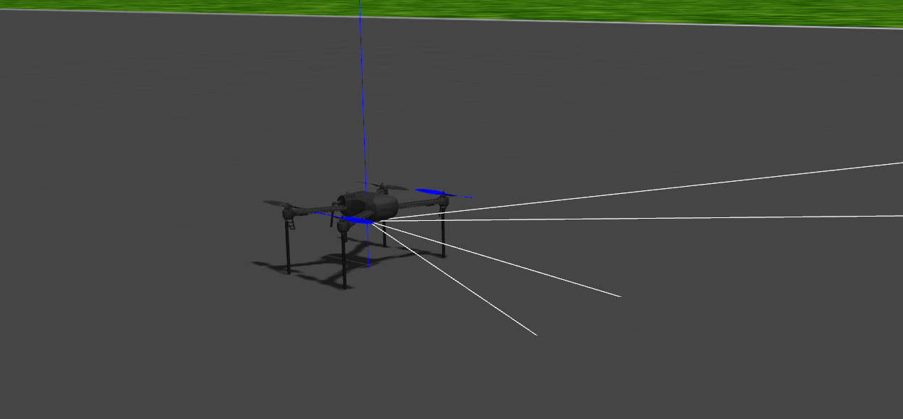
DroneRush
DRONE SIMULATION USING ROS AND GAZEBO
DGMD E-17
Aboubacar Bah

Slide 2
Content
Goal
Hardware and Software
Source Code
Simple Program
Obstacle Avoidance
Challenges
Future Work

Slide 3
Goal
Drone Control
Fly drone to waypoints
Adding Sensors to Drone
Obstacle Avoidance using Lidar for Drones

Slide 4
Hardware and Software
Asus Q524UQ
Ubuntu 20.04.2 LTS
Python 3.8.5
Catkin Workspace
Matplotlib, opencv, scipy, …
Ardupilot
Mavros and Mavlink
Gazebo11
ROS Noetic

Slide 5
Source Code
https://github.com/Boubisto/DGMD-E-17
http://wiki.ros.org/ROS/Tutorials/
http://gazebosim.org/tutorials
https://ardupilot.org/ardupilot/index.html
http://users.isr.ist.utl.pt/~mir/pub/ObstacleAvoidance.pdf

Slide 6
Simple Program
Program to fly a drone
C++
//initialize ros
ros::init(argc, argv, "gnc_node");
ros::NodeHandle gnc_node;
//initialize control publisher/subscribers
init_publisher_subscriber(gnc_node);
// wait for FCU connection
wait4connect();
//wait for used to switch to mode GUIDED
wait4start();
//create local reference frame
initialize_local_frame();
//request takeoff
takeoff(3);

Slide 7
Simple Program
Demo

Slide 8
Simple Program
Program to fly a drone to waypoints
C++
std::vector<gnc_api_waypoint> waypointList;
gnc_api_waypoint nextWayPoint;
nextWayPoint.x = 0;
nextWayPoint.y = 0;
nextWayPoint.z = 3;
nextWayPoint.psi = 0;
waypointList.push_back(nextWayPoint);
nextWayPoint.x = 5;
nextWayPoint.y = 0;
nextWayPoint.z = 3;
nextWayPoint.psi = -90;

Slide 9
Simple Program
Demo

Slide 10
Obstacle Avoidance
Obstacle Avoidance Program with Ardupilot
C++
Parse the Lidar Data
sensor_msgs::LaserScan current_2D_scan;
current_2D_scan = *msg;
float avoidance_vector_x = 0;
float avoidance_vector_y = 0;
bool avoid = false;
for(int i=1; i<current_2D_scan.ranges.size(); i++)
{
float d0 = 3;
float k = 0.5;
if(current_2D_scan.ranges[i] < d0 && current_2D_scan.ranges[i] > .35)
{
avoid = true;
float x = cos(current_2D_scan.angle_increment*i);
float y = sin(current_2D_scan.angle_increment*i);
float U = -.5*k*pow(((1/current_2D_scan.ranges[i]) - (1/d0)), 2);
avoidance_vector_x = avoidance_vector_x + x*U;
avoidance_vector_y = avoidance_vector_y + y*U;
}
}
Take off and control Loop
//initialize control publisher/subscribers
init_publisher_subscriber(n);
// wait for FCU connection
wait4connect();
//wait for user to switch to mode GUIDED
wait4start();
//create local reference frame
initialize_local_frame();
//request takeoff
takeoff(2);
set_destination(0,0,2,0);
ros::Rate rate(2.0);
int counter = 0;
while(ros::ok())
{
ros::spinOnce();
rate.sleep();
}

Slide 11
Obstacle Avoidance
Demo

Slide 12
Challenges and Future Work
Software Compatibility
Parameters tuning
Autonomous Drone Simulation
Controlling Multiple Drones
Utilize Mission Planner

Slide 13
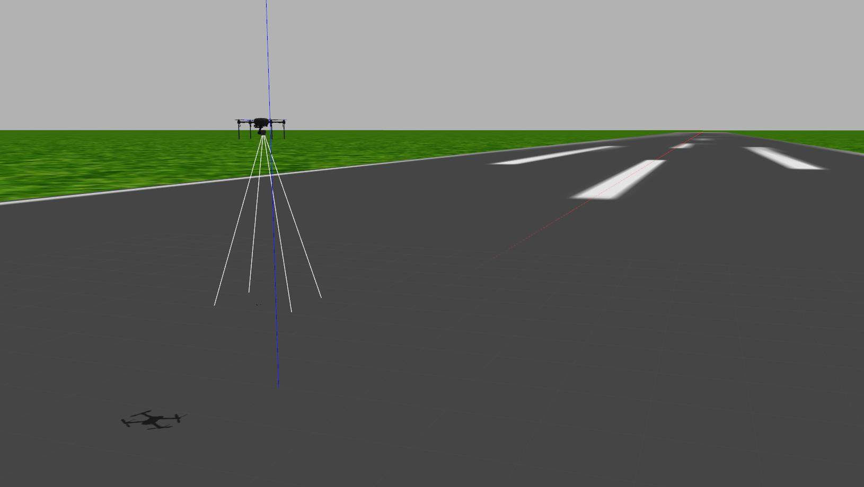
End
Thank you for your time!

